Slide 1
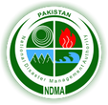
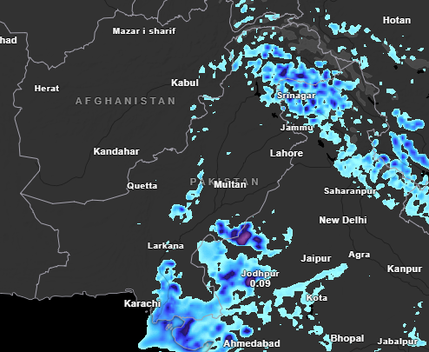
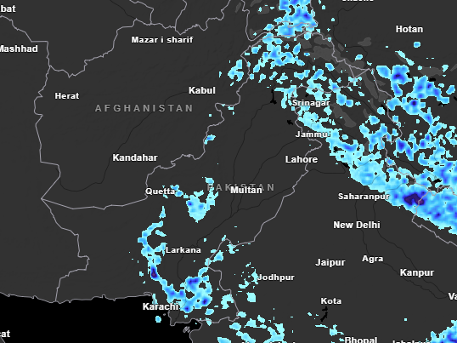
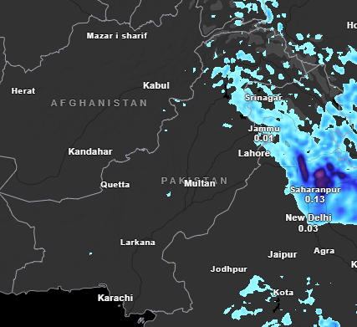
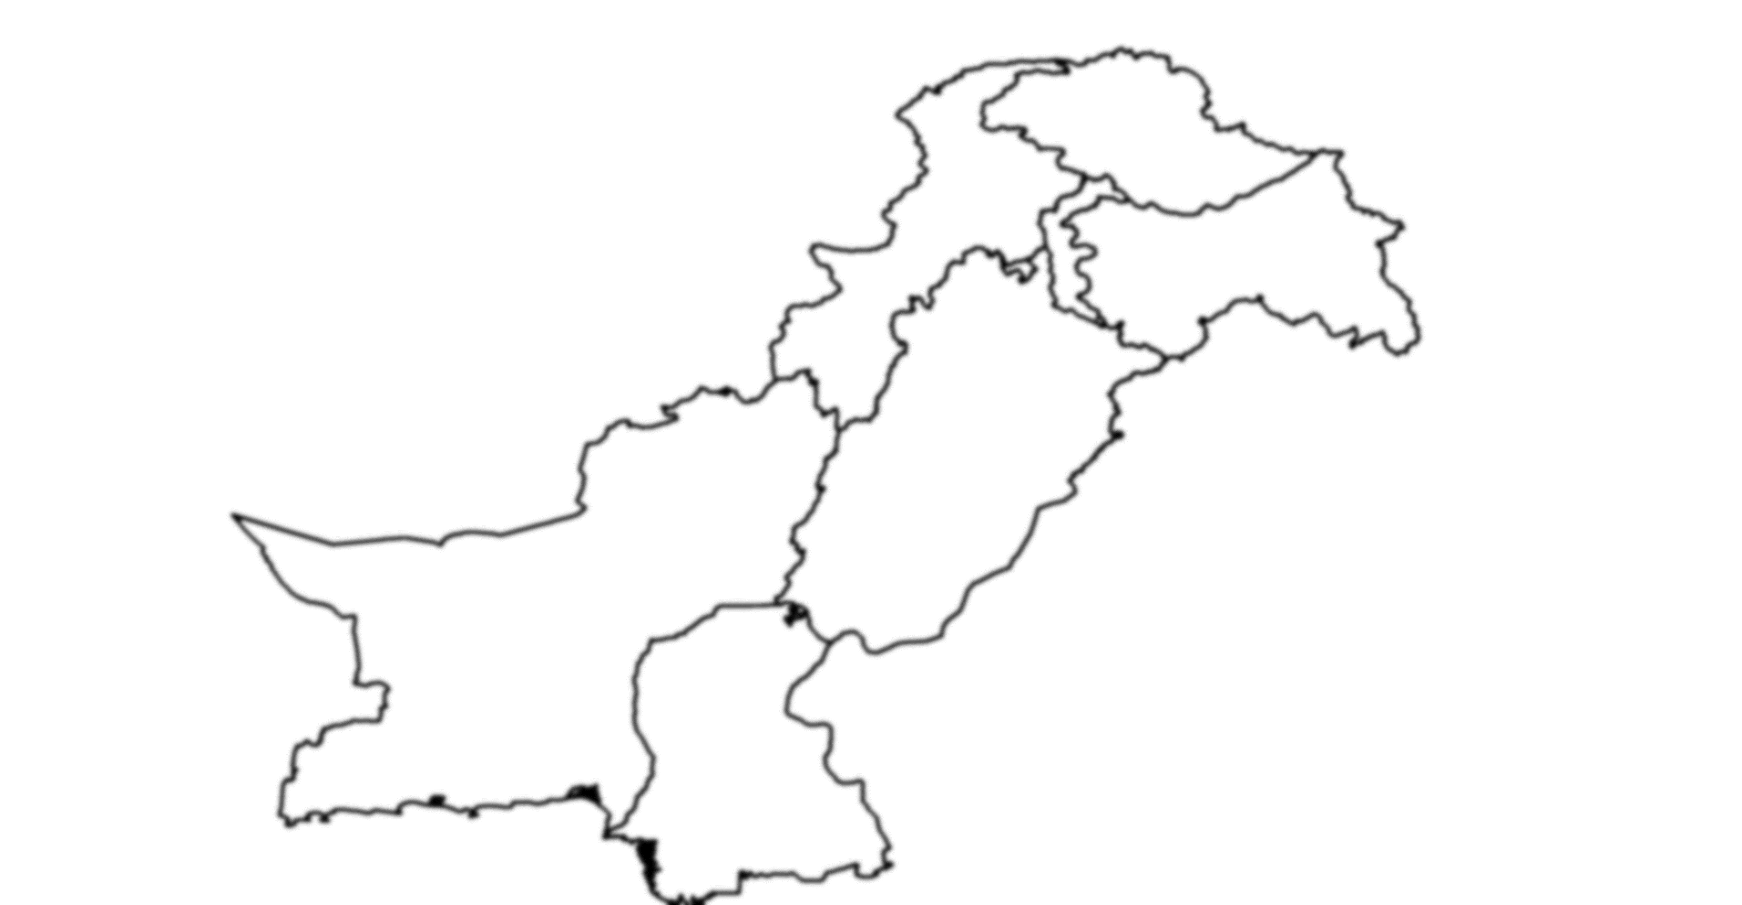
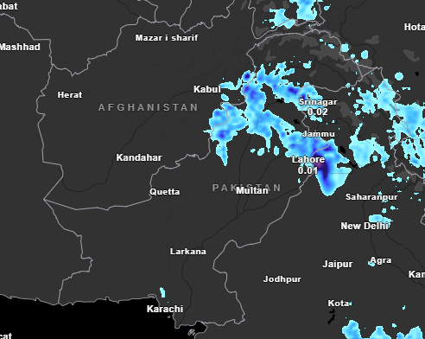
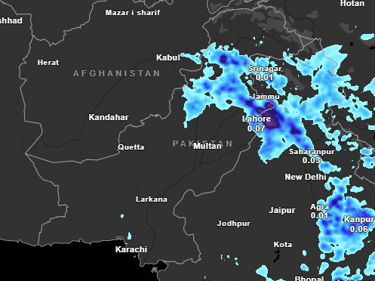
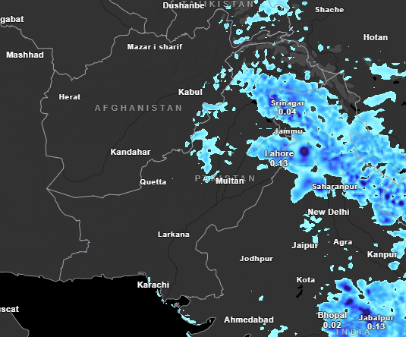
Weather Advisory (19th to 24th July, 2025)
National Emergency Operation Centre - National Disaster Management Authority
19th July
20th July
21th July
Moisture from the Bay of Bengal and the Arabian Sea, coupled with the influence of low-pressure systems developing in the surrounding regions, is expected to bring moderate to heavy rainfall across most parts of the country in the coming days.
Punjab:
Moderate to heavy rainfall is expected in upper and northeastern parts of the province including Islamabad, Rawalpindi, Murree, Galliyat, Attock, Chakwal, Jhelum, Mianwali, Hafizabad, Sargodha, Faisalabad, Sialkot, Narowal, Okara, Lahore, Gujranwala, Gujrat, Multan, Bahawalpur, Bahawalnagar, Rahim yar Khan, Dera Ghazi Kahn, and surrounding areas from 21st of July to 24th of July, 2025 with occasional gaps.
Balochistan:
Isolated rainfall is expected Ziarat, Kalat, Musakhel, Khuzdar, Awaran, Barkhan Sibbi, Jaffarabad, Dera Bugti, and surrounding areas from 20th of July to 24th of July, 2025
22th July
23rd July
24th July
Sindh:
Low to moderate rainfall is expected in Sukkur, Larkana, Jacobabad, Khairpur, Karachi, Hyderabad, Tharparkar, Thatta, Badin, Mirpur Khas, and surrounding areas from 19th of July to 24th of July, 2025.
KP:
Moderate to heavy rainfall is expected in Chitral, Dir, Haripur, Karak, Kohat, Kohistan, Khyber, Kurram, Mansehra, Mohmand, Nowshera, Malakand, Charsadda, Abbottabad, Bannu, Buner, Hazara, Peshawar, Swabi, Swat, Waziristan, and surrounding areas from 19th of July to 24th of July, 2025
GB & AJK:
Isolated rainfall is expected in Astore, Skardu, Hunza, Shighar, Bagh, Neelum Valley, Muzaffarabad, and surrounding areas from 19th of July to 24th of July, 2025.

